Slide 1


Slide 2

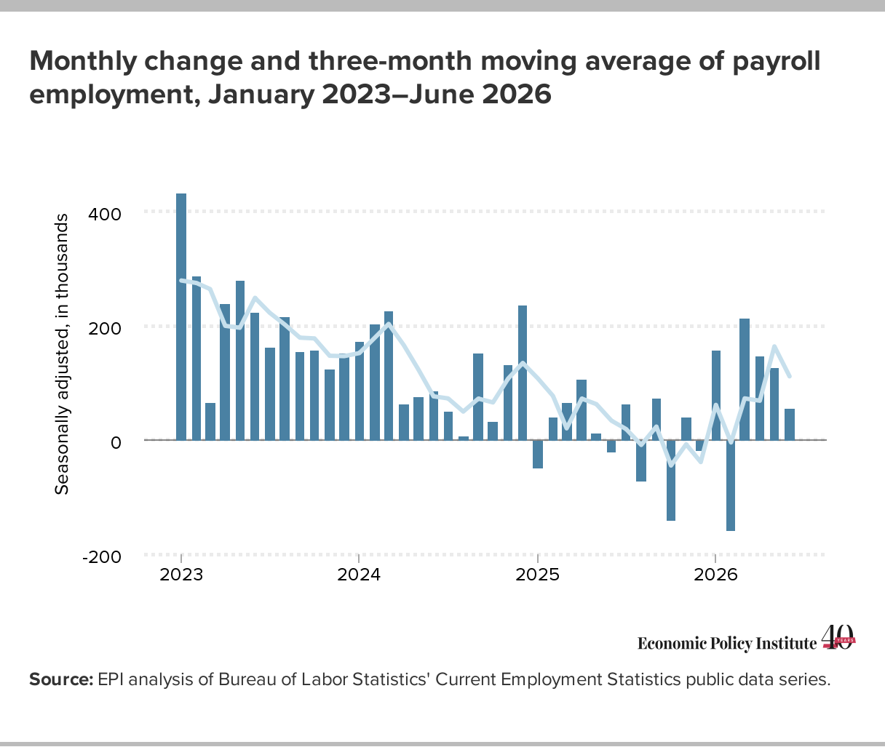

Slide 3
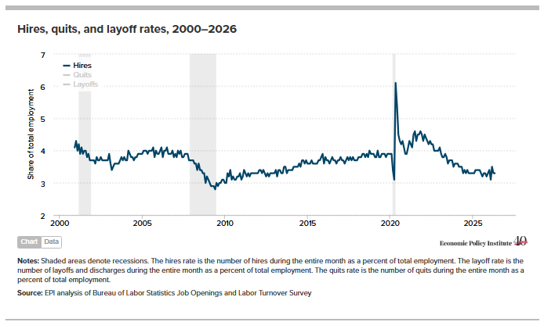

Slide 4
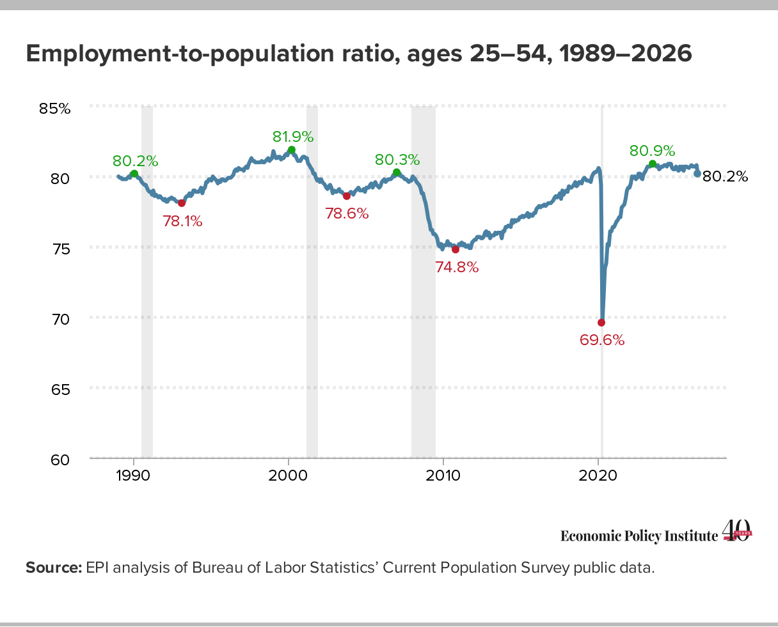

Slide 5
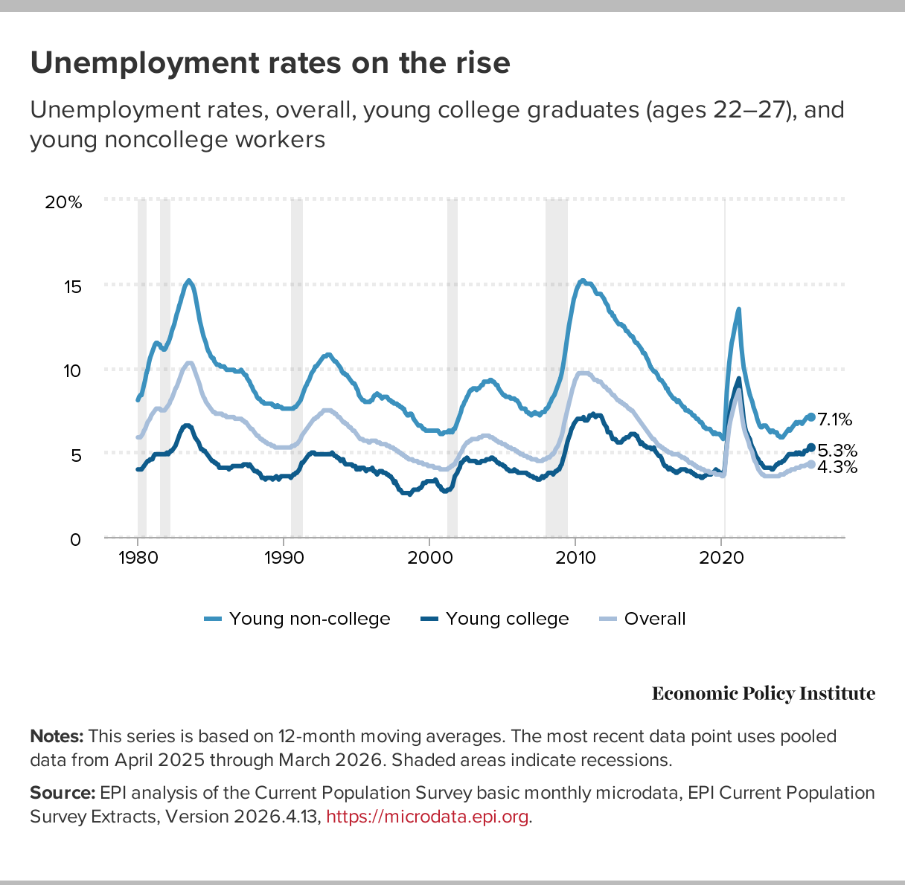

Slide 6
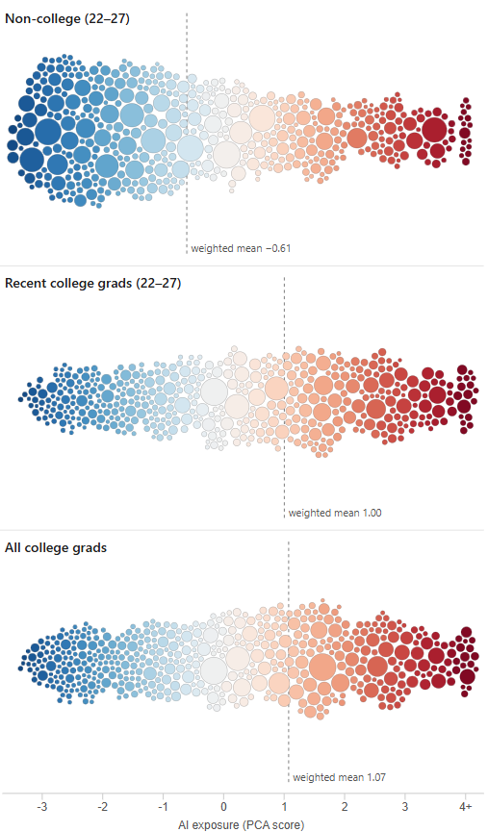
College grads, including young college grads, are more likely to be employed in AI- exposed occupations:
AI-exposure of occupations weighted by number of workers in each occupation, by demographic group
Notes:
https://www.epi.org/blog/class-of-2026-what-occupation-data-show-about-ai-and-the-young-college-graduate-workforce/

Slide 7
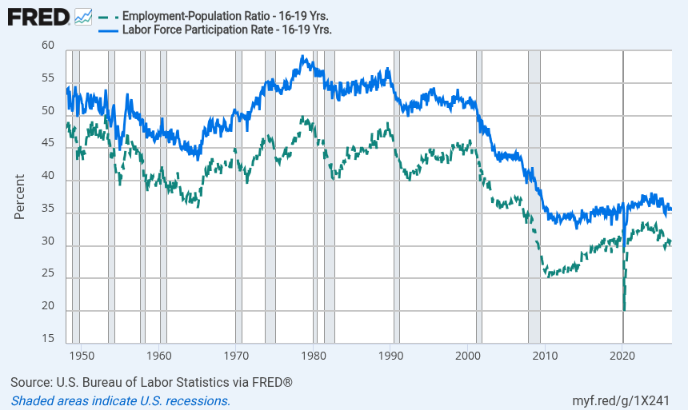
Notes:
Source:
U.S. Bureau of Labor Statistics
Release:
Employment Situation
Units:
Percent, Seasonally Adjusted
Frequency:
Monthly
The series comes from the 'Current Population Survey (Household Survey)'The source code is: LNS12300012
U.S. Bureau of Labor Statistics,
Employment-Population Ratio - 16-19 Yrs. [LNS12300012],
retrieved from FRED,
Federal Reserve Bank of St. Louis;
https://fred.stlouisfed.org/series/LNS12300012,
.
Source:
U.S. Bureau of Labor Statistics
Release:
Employment Situation
Units:
Percent, Seasonally Adjusted
Frequency:
Monthly
The series comes from the 'Current Population Survey (Household Survey)'The source code is: LNS11300012
U.S. Bureau of Labor Statistics,
Labor Force Participation Rate - 16-19 Yrs. [LNS11300012],
retrieved from FRED,
Federal Reserve Bank of St. Louis;
https://fred.stlouisfed.org/series/LNS11300012,
.

Slide 8
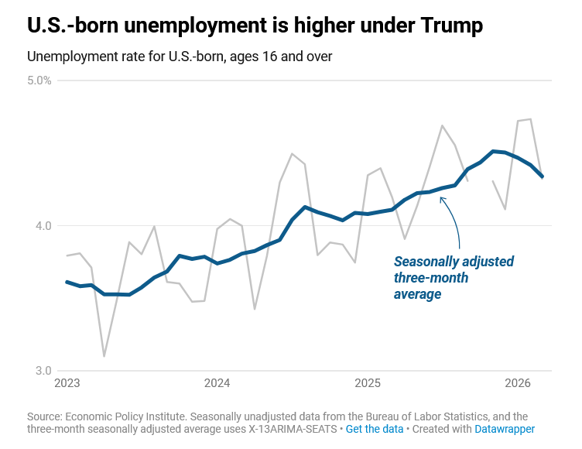

Slide 9
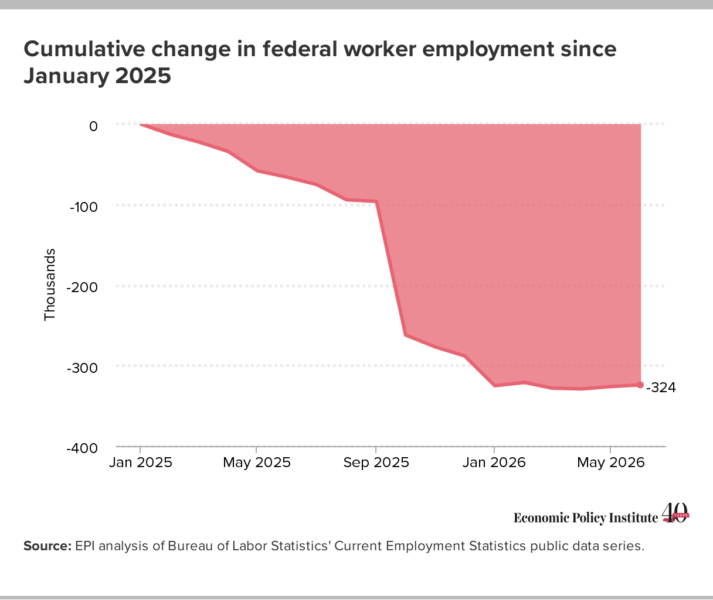

Slide 10
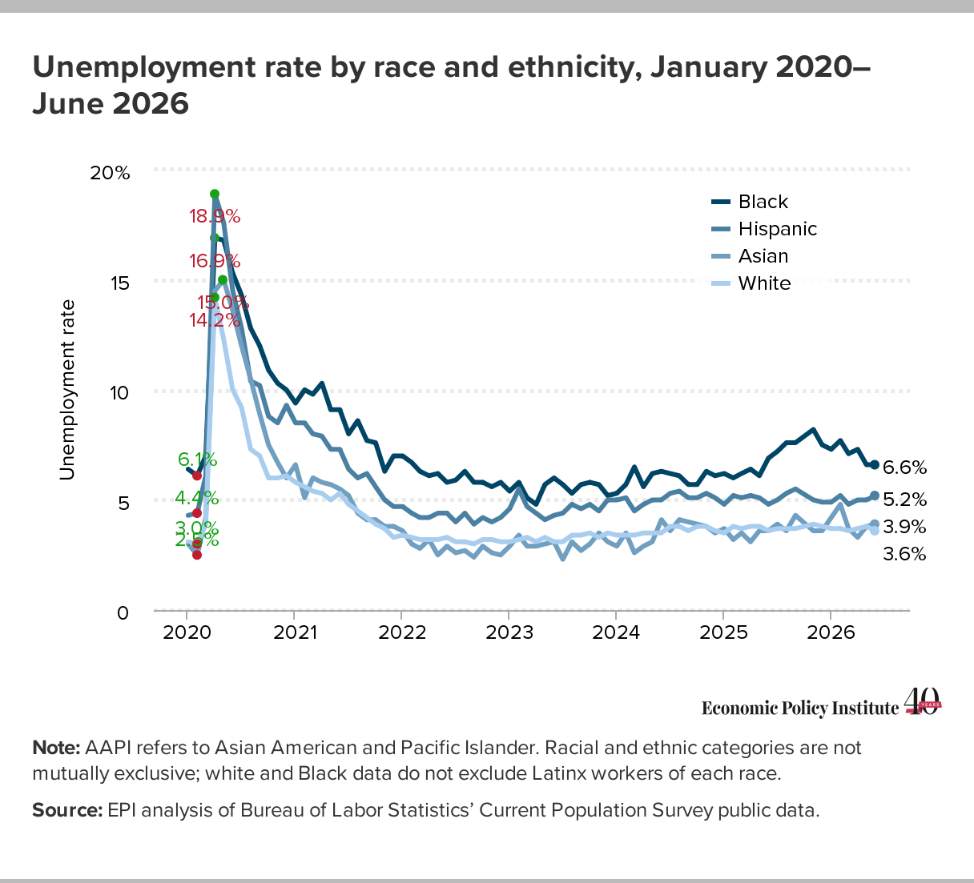

Slide 11
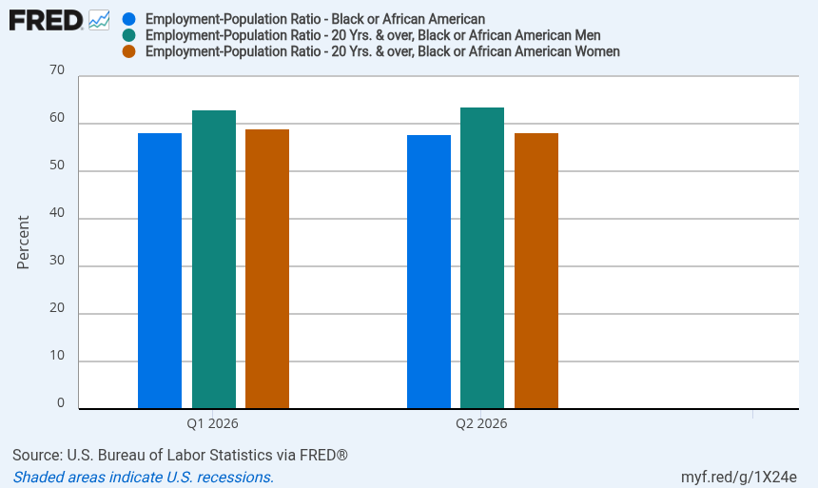
63.1
63.6
59.1
58.2
57.8
58.1
Notes:
Source:
U.S. Bureau of Labor Statistics
Release:
Employment Situation
Units:
Percent, Seasonally Adjusted
Frequency:
Monthly
The series comes from the 'Current Population Survey (Household Survey)'The source code is: LNS12300006
U.S. Bureau of Labor Statistics,
Employment-Population Ratio - Black or African American [LNS12300006],
retrieved from FRED,
Federal Reserve Bank of St. Louis;
https://fred.stlouisfed.org/series/LNS12300006,
.
Source:
U.S. Bureau of Labor Statistics
Release:
Employment Situation
Units:
Percent, Seasonally Adjusted
Frequency:
Monthly
The series comes from the 'Current Population Survey (Household Survey)'The source code is: LNS12300031
U.S. Bureau of Labor Statistics,
Employment-Population Ratio - 20 Yrs. & over, Black or African American Men [LNS12300031],
retrieved from FRED,
Federal Reserve Bank of St. Louis;
https://fred.stlouisfed.org/series/LNS12300031,
.
Source:
U.S. Bureau of Labor Statistics
Release:
Employment Situation
Units:
Percent, Seasonally Adjusted
Frequency:
Monthly
To obtain estimates of women worker employment, the ratio of weighted women employees to the weighted all employees in the sample is assumed to equal the same ratio in the universe. The current month's women worker ratio, thus, is estimated and then multiplied by the all-employee estimate. The weighted-difference-link-and-taper formula (described in the source) is used to estimate the current month's women worker ratio. This formula adds the change in the matched sample's women worker ratio (the weighted-difference link) to the prior month's estimate, which has been slightly modified to reflect changes in the sample composition (the taper).The series comes from the 'Current Population Survey (Household Survey)'The source code is: LNS12300032
U.S. Bureau of Labor Statistics,
Employment-Population Ratio - 20 Yrs. & over, Black or African American Women [LNS12300032],
retrieved from FRED,
Federal Reserve Bank of St. Louis;
https://fred.stlouisfed.org/series/LNS12300032,
.

Slide 12
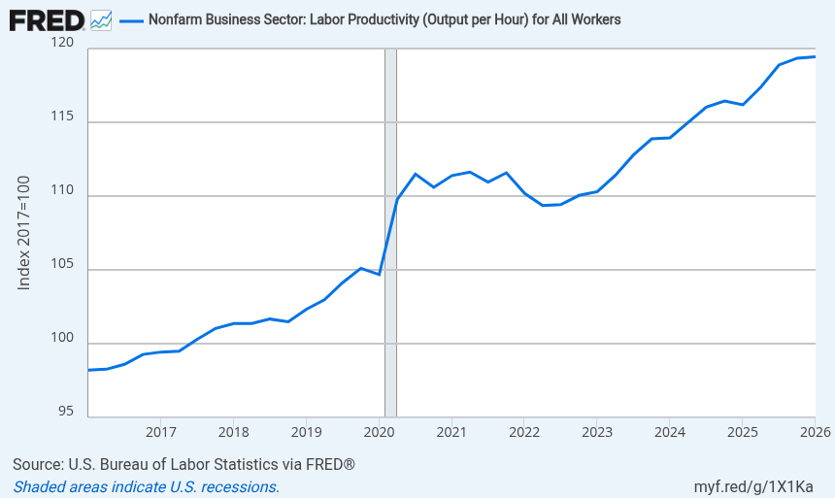

Slide 13
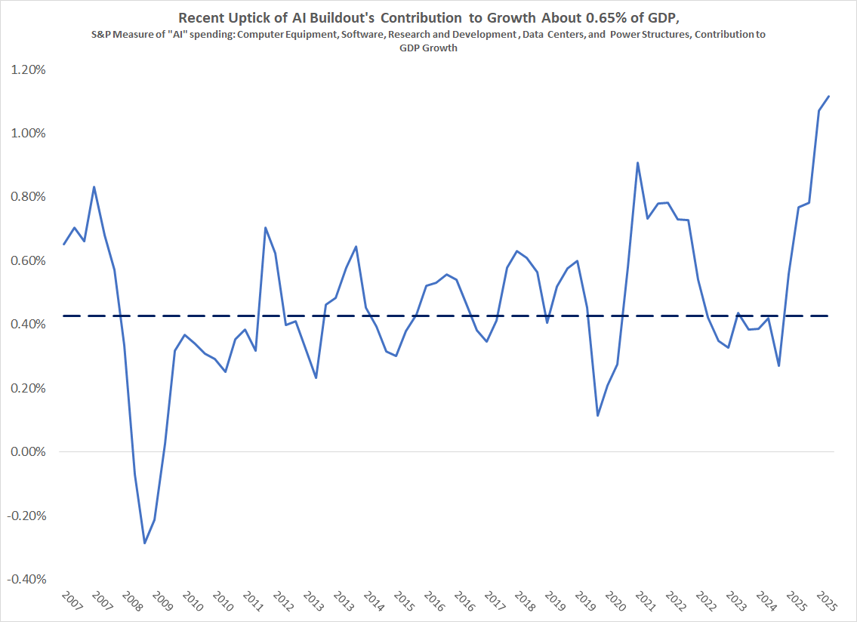

Slide 14
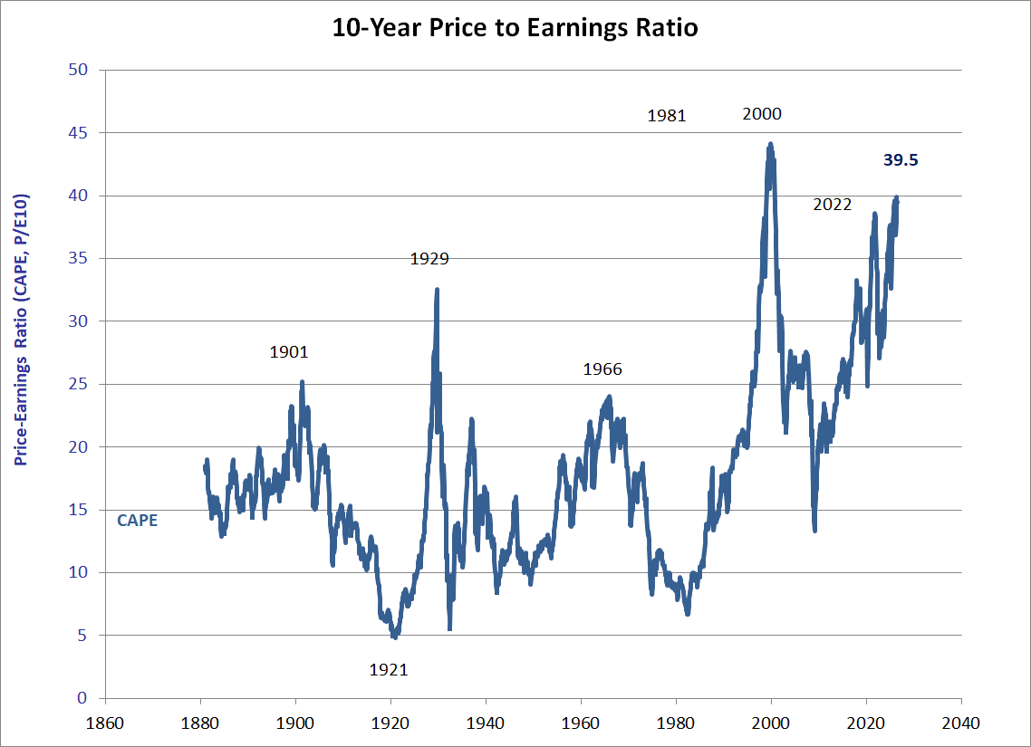

Slide 15
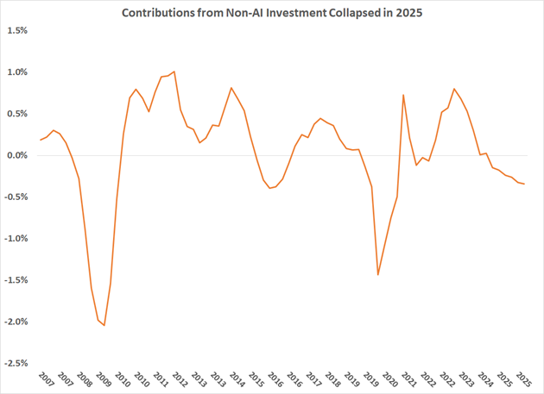

Slide 16
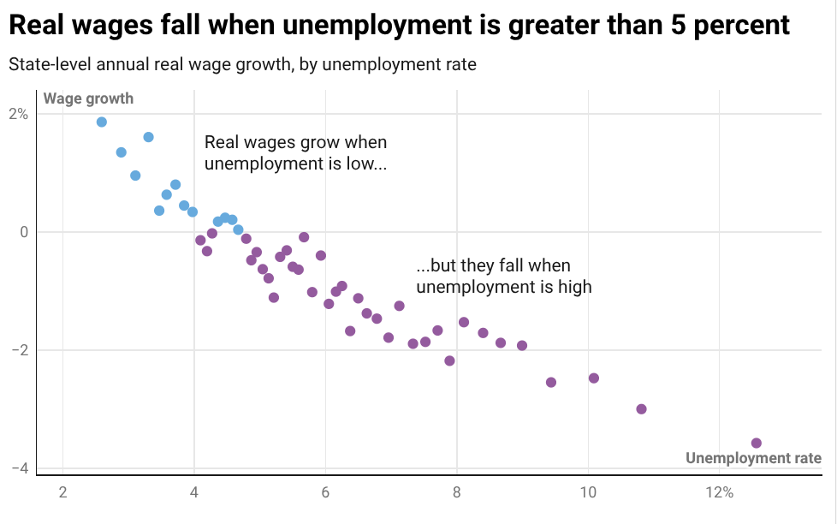

Slide 17
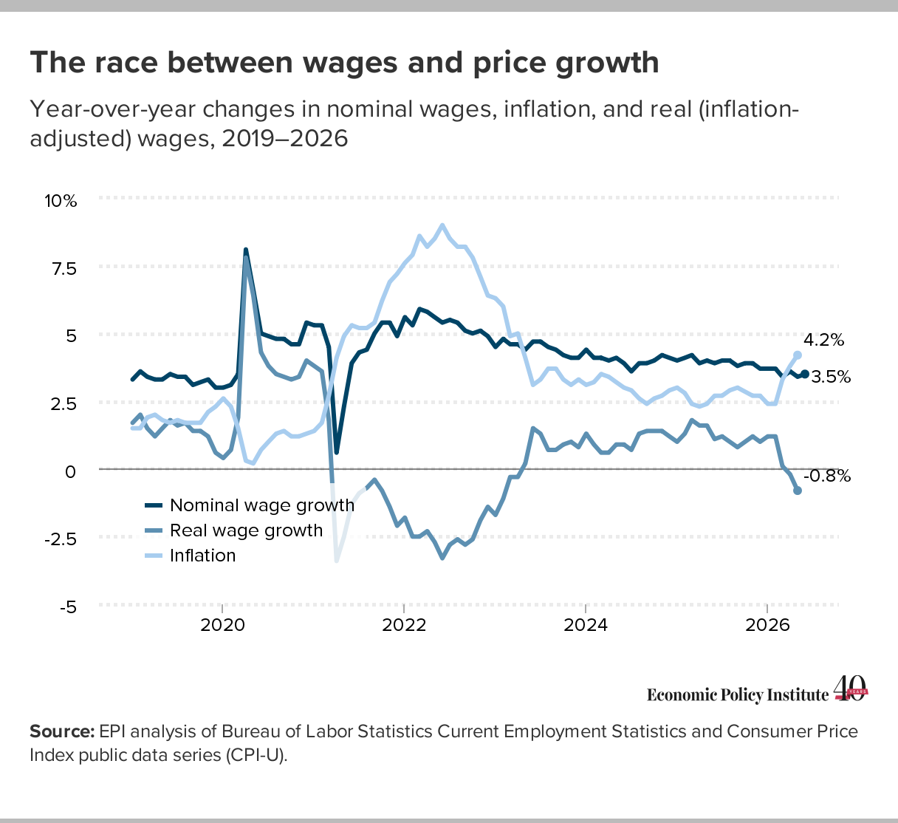

Slide 18
