Slide 1
Explaining the erosion of private-sector unions
Lawrence Mishel, Lynn Rhinehart, and Lane Windham
https://www.epi.org/unequalpower/publications/private-sector-unions-corporate-legal-erosion/
@LaneWindham, @LarryMishel
December 17, 2020
Unequal Bargaining Power initiative: https://www.epi.org/unequalpower/

Slide 2
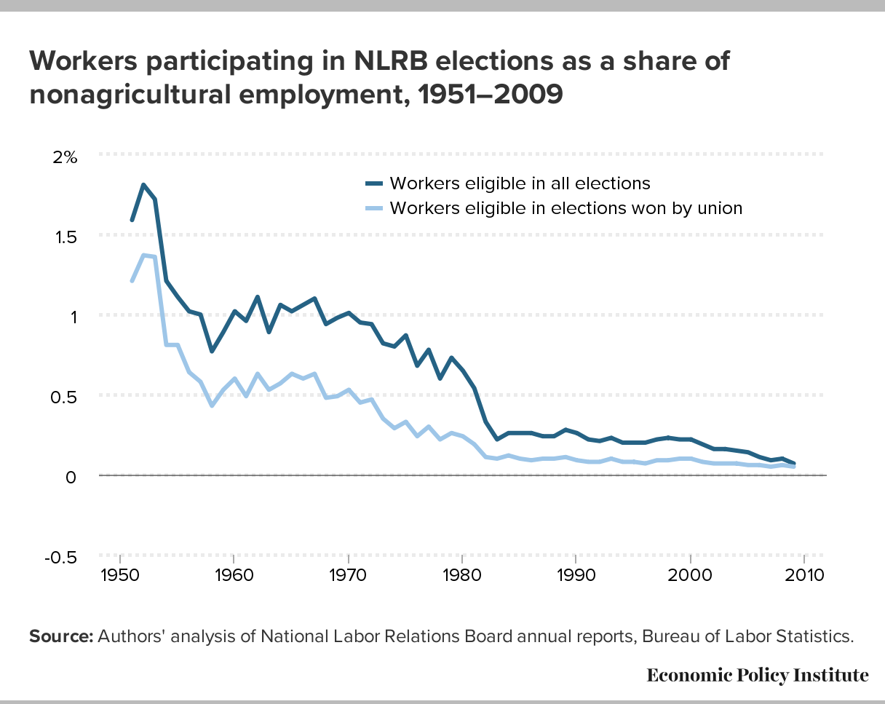
Sharp Decline in Share of Workers in Union Elections and Wins over the 1970’s

Slide 3
Election Activity Reduced to Trickle
In the 1950s and 1960s more than 1.0% of those employed participated in an NLRA election each year
Share of Employment in NLRA elections:
1970’s: 0.78%
1980’s: 0.29%
2000’s: 0.13%
Share of Employment in successful NLRA election:
1950’s: 0.83% 2000’s: 0.06%
1950s equivalent today, would be more than 1 million new union members each year!

Slide 4
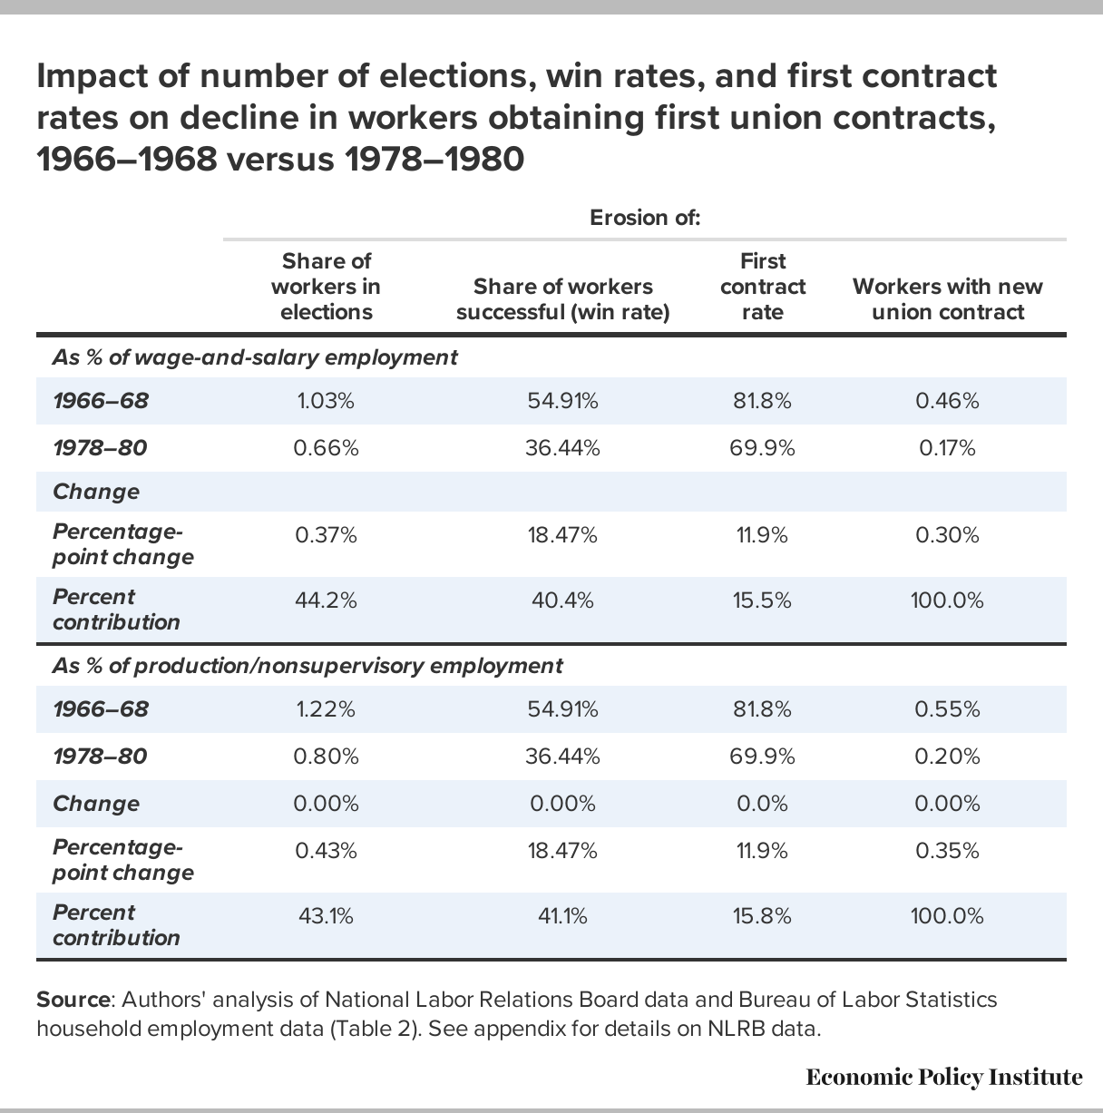
Quantifying the Three Hurdles to a Union Contract

Slide 5
Understanding decline in flows into unions over 1970’s
Reduction in workers obtaining new union contract
1966-68: 0.46% of employment
1978-80: 0.17% of employment
Down 0.30% of employment
Explained by (sums to 100%):
Fewer elections-- 44.2%
Lower win rate– 40.4%
Inability to obtain first contract-- 15.5%
Consequence: 200,000 fewer new union members with contract each year by end of 1970’s. In today’s workforce, late 1960’s rate of union inflow would be 560,000 each year.

Slide 6
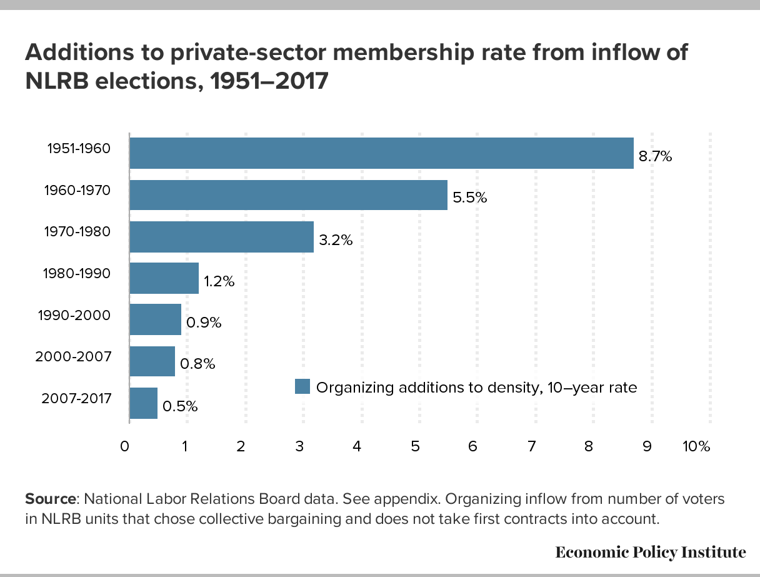
The Steep Decline in Additions to Private Sector union coverage

Slide 7
Strong and Growing Worker Demand for Collective Bargaining
“the 1977 and 1995 results were nearly identical: approximately one third of the non-union workforce indicated they would vote to have union representation if given an opportunity to do so on their current job. In 2017 that number increased to 48 percent. This number translates into an under-representation of unions of approximately 58 million workers.”
Based on Kochan, Kimball, Yang, and Kelly (2018)

Slide 8
Automation/Globalization had Minor Role in Private Sector Union Decline
Private-sector unionization eroded rapidly in nonmanufacturing, frequently more than in manufacturing: in both major sectors and in many detailed industries.
Detailed statistical analyses show that changing employment patterns across industries can account for less than a fifth of union erosion.
International comparisons show manufacturing decline explains very little of cross-country differences in union decline (OECD 2020).

